Slide 2
Digital Twin
What does a company need to fully digitize the business?
Assess the current state
The company needs to assess their current state of digitization and identify the areas that need improvement. This will help the company understand where they need to focus their efforts.
Develop a digital strategy
The company needs to develop a digital strategy that aligns with their business goals. The strategy should identify the key technologies and tools that the company needs to implement to achieve their goals.

Slide 3




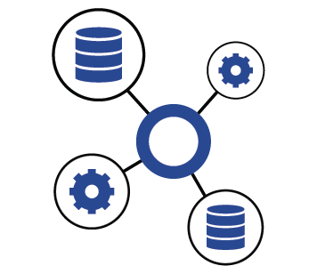



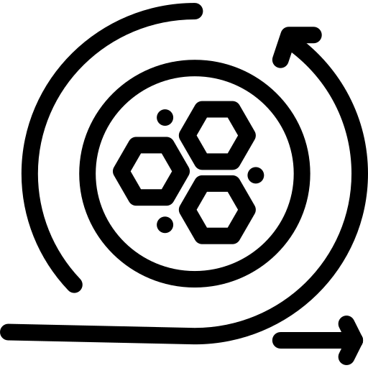


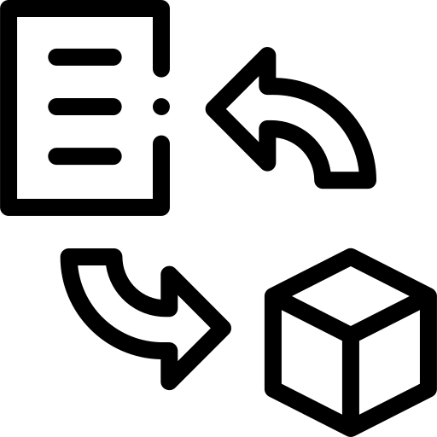

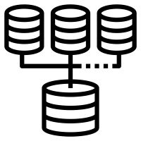

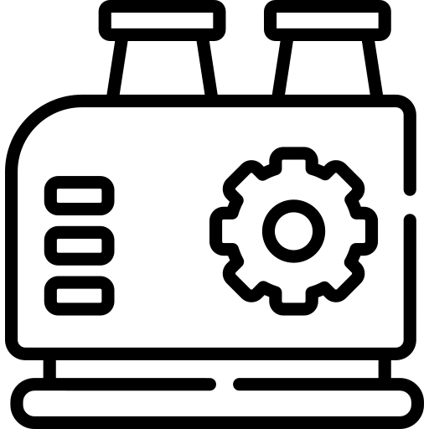

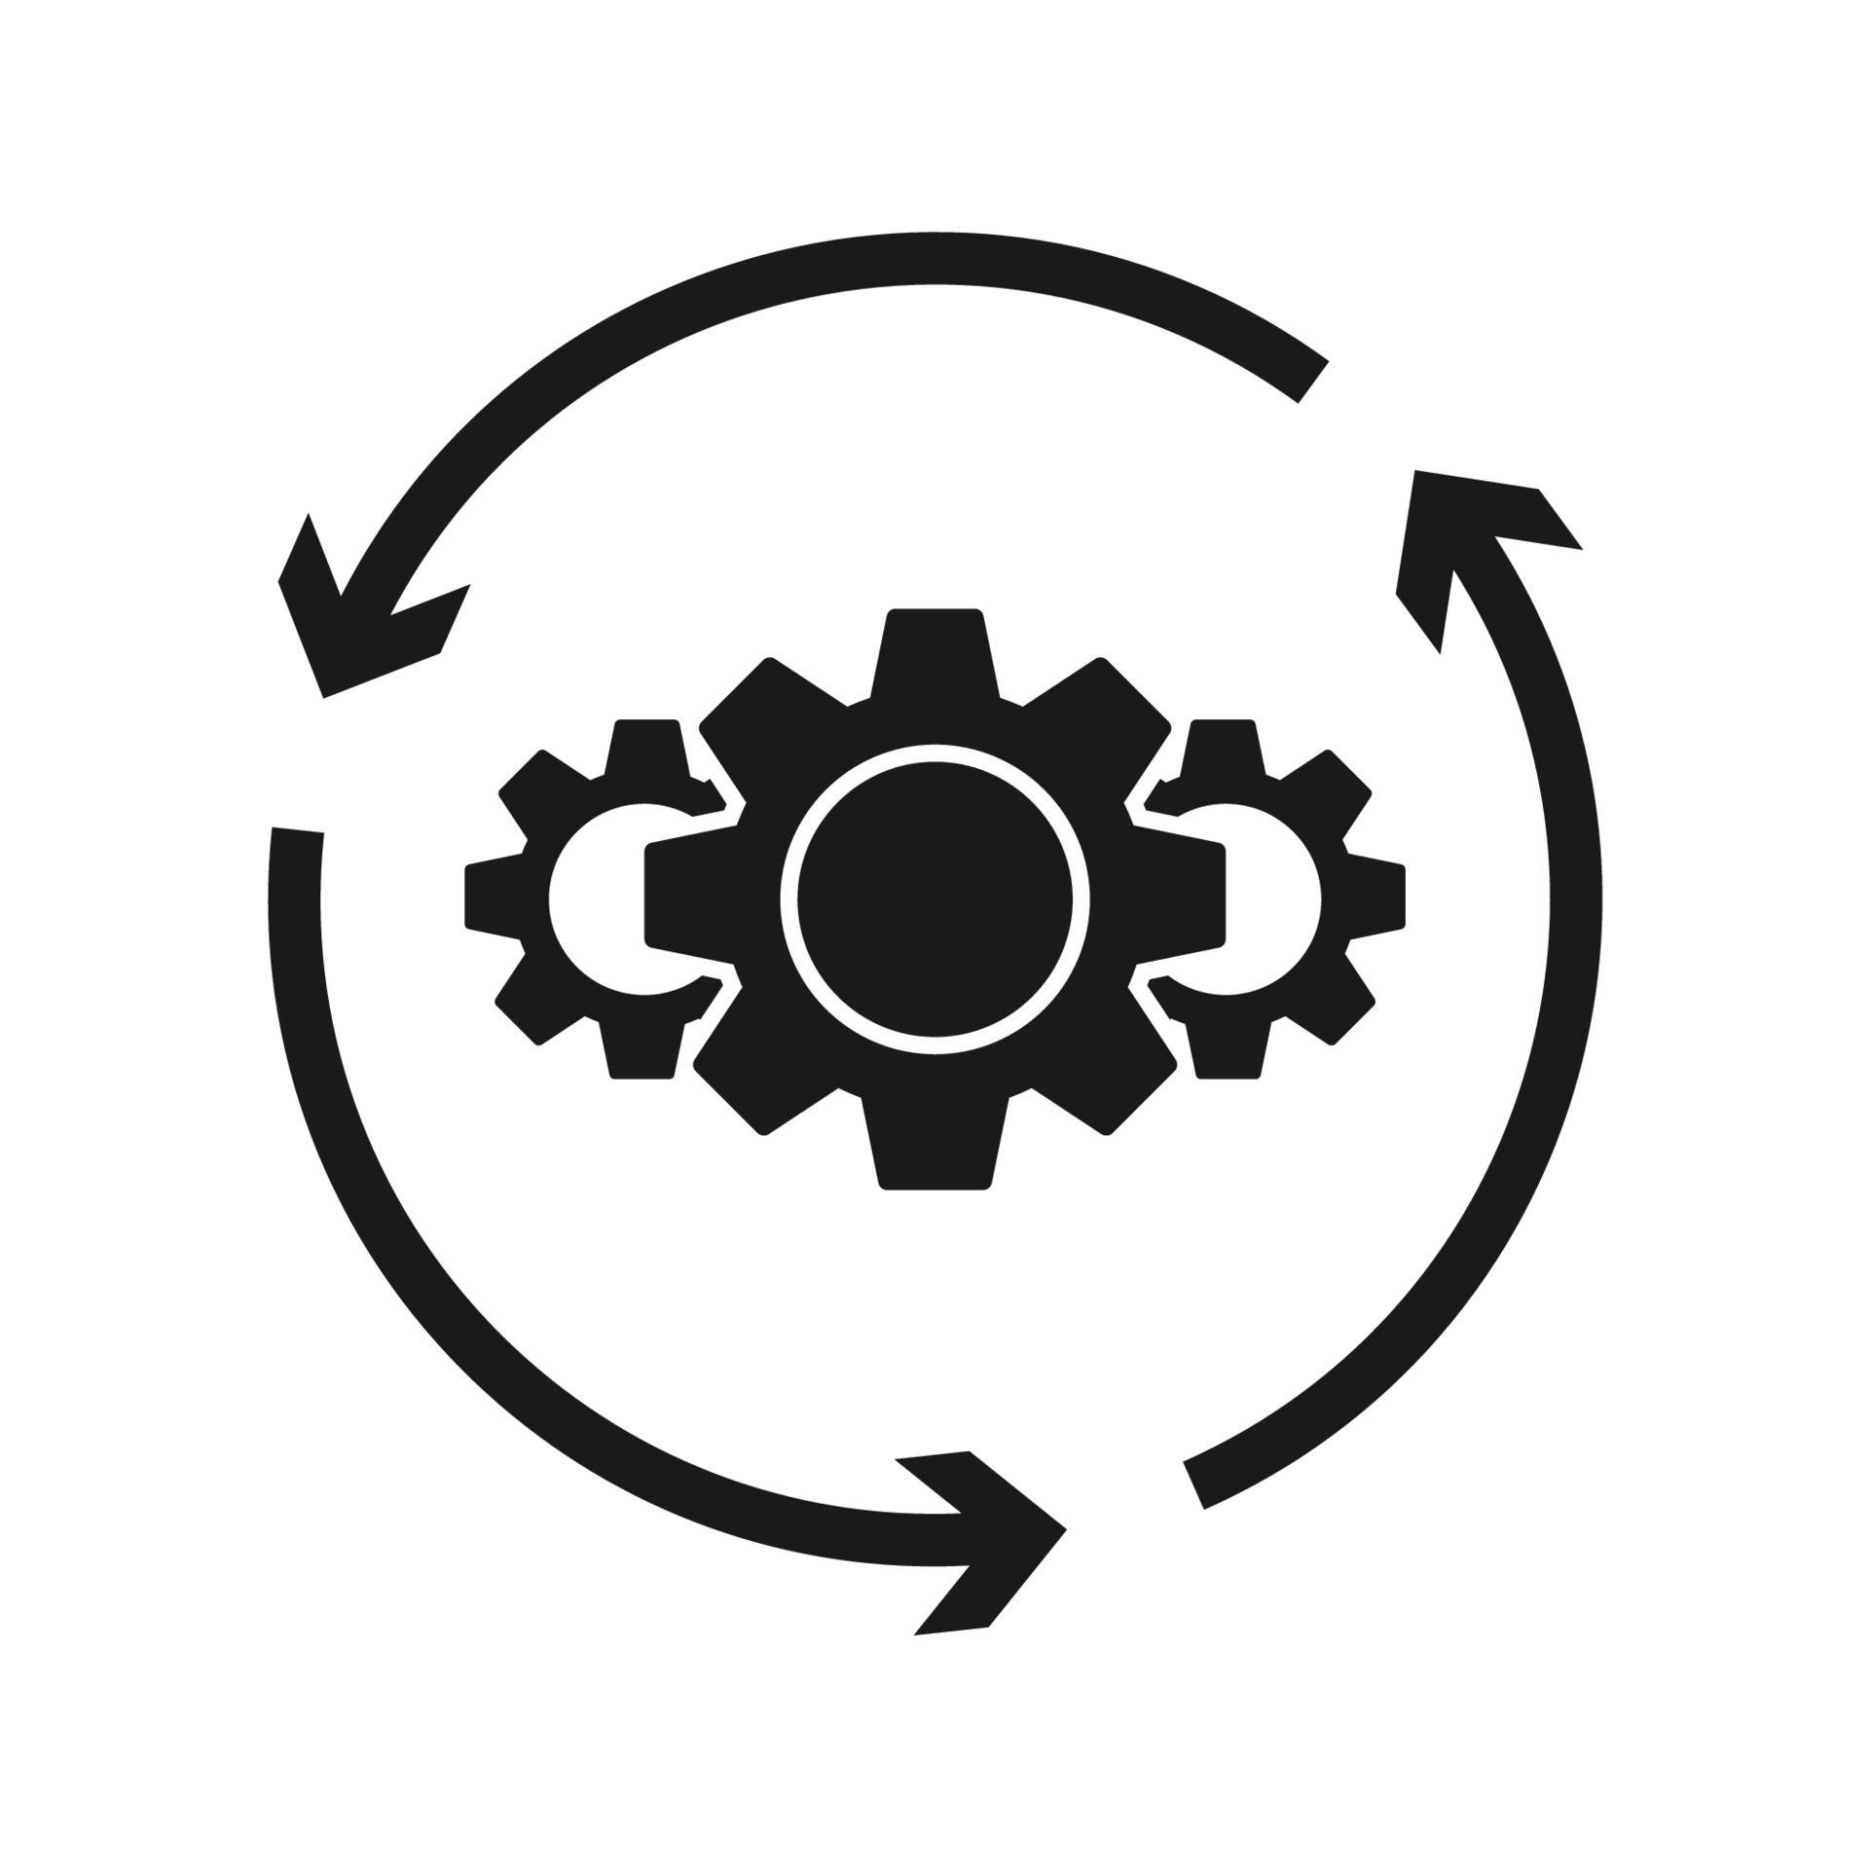
Digital Twin
What does a company need to fully digitize the business?
To fully digitize a business, a company needs to undertake a comprehensive digital transformation that involves the digitization of all aspects of its operations.
Digital Infrastructure: This includes hardware such as servers, computers, and networking equipment, as well as software such as operating systems, databases, and productivity tools.
Digital Culture: This involves training/hiring employees on new technologies and providing them with the resources they need to succeed.
Digital Services
Monitoring
Visualization
Optimization
Predictive Maintenance
Digital Twins
Data
Information
Data Models
Standards
Data Modelling Tools
Digital Data
Status Data
Process Data
Data Transition
Data Processing
Data Integration
Physical Assets
Sensors
Machines
Buildings
Process

Slide 4
Digital Twin (DT)
What does a company need to fully digitize the business?
Digital Twin:
Digital Twin is a comprehensive virtual representation of a physical entity, process, or service that facilitates data-driven decision-making and eliminates inefficiencies in business processes.
This technology essentially creates a virtual model of the physical world, along with all of its various relationships.
Digital Twins are persistent digital models that capture the structure, behavior, and context of the physical entity, process, or service.
Digital twins are continuously updated and used throughout the product’s lifecycle-from design to manufacturing and construction, to operation and maintenance, and even for future use or reuse.

Slide 5
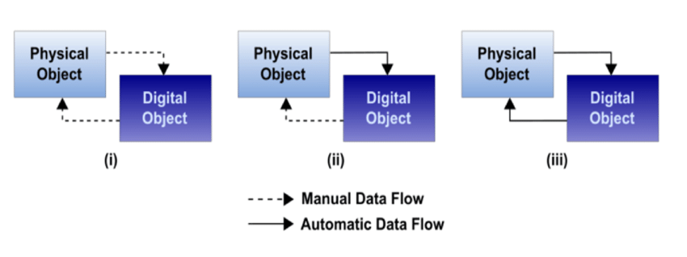
Digital Twin (DT)
What is a digital twin (DT) in the IoT context?
Digital Models:
Static Digital Model:
while the static model data is accumulated over time, making it better suited for long-term strategic planning.
Digital Shadow:
The data from the physical object flow to the digital automatically, but this is still manual the other way around.
Dynamic Digital Model:
The data in the dynamic model are continuously updated in real-time, allowing for immediate control actions
(i) Digital Model; (ii) Digital shadow/Static Digital model; (iii) Digital Twin/Dynamic Digital Model.
https://www.researchgate.net/figure/Types-of-DT-based-on-level-of-integration-adapted-from-2-i-Digital-Model-ii_fig5_351827732

Slide 6
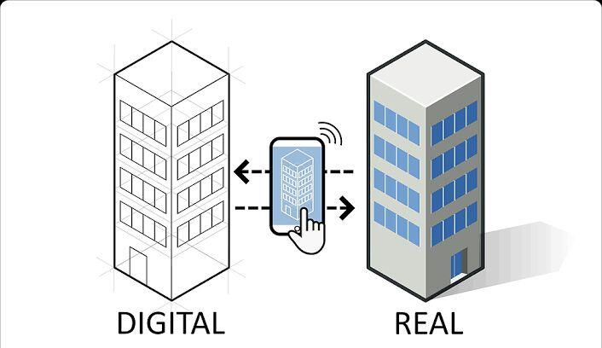
Digital Twin (DT)
What does a company need to fully digitize the business?
Creating Digital Twin:
To create a virtual architecture, a digital twin needs real time flow of data about the object, system or process by scanning the physical counterparts in the real world.
Once the data is gathered, it is fed into the IoT systems and computational analytical models are created with the help of BIM, CAD and GIS software.
The models are then displayed through 3D representations and AR techniques to simulate real-world conditions and visualize the outcomes on any device including smartphones, computers and AR/VR devices.
An example: Smart Buildings
https://structville.com/digital-twin-in-the-aec-industry

Slide 7
Digital Twin (DT)
What does a company need to fully digitize the business?
Digital Twin Tasks:
The main goal of a DT is that it pursues the lifecycle and the data integrated with the device.
The main asset of a DT is to implement an abstraction layer that allows IoT applications to communicate with devices continuously.
data is unified through contextualization and structured into industry standards.
The data obtained from source and domain models can be utilized for deploying and expanding solutions.
Digital Twins
Data
Information
Data Models
Standards
Data Modelling Tools

Slide 8
Digital Twin (DT)
What does a company need to fully digitize the business?
Physical asset process:
the digital twin deployment normally starts small, viz the performance of a single component within a product but expands and evolves over time. This however happens in two ways.
Firstly, a small number of digital twins are made together to give a complete picture of the asset, process or system.
Secondly, more sophisticated capabilities are added to the existing digital twin to study predict future performance of the physical counterpart.
Physical Assets
Sensors
Machines
Buildings
Process

Slide 9
Digital Twin (DT)
What is a digital twin (DT) in the IoT context?
Digital Data:
The digital twin architecture is kept accurate by using sensors placed in critical functional areas of the physical object.
These sensors gather real-time performance data from the physical object and send it back to the IT software, which uses it to simulate the real-world object in a digital space.
The sensors continuously gather data throughout the lifetime of the physical object.
This data is used to update the digital twin whenever any changes are made to the physical object.
This helps companies identify any flaws in the product and make necessary repairs, ultimately improving the performance of the product.

Slide 10
Digital Twin (DT)
What is a digital twin (DT) in the IoT context?
Data Models:
DT use of AI, ML, and IOT technologies allows digital twins to learn, update, and communicate with their physical counterparts through data exchange.
This technology enables users to predict and prevent issues, shorten development time, explore new opportunities, and achieve greater efficiency and effectiveness.
The level of complexity of the digital twin is determined by its intended purpose.
It may simply serve to monitor and analyze a physical prototype, or it may enable users to run simulations, detect issues and anomalies, identify potential solutions based on advanced data analytics, and assess the capabilities of the product.
Digital Twins
Data
Information
Data Models
Standards
Data Modelling Tools

Slide 11
Digital Twin (DT)
What is a digital twin (DT) in the IoT context?
Digital service Environmental monitoring :
Energy Field as example:
Application of Machine Learning that enables the optimization of energy consumption by controlling temperature and energy usage.
This system provides real-time alerts for critical situations such as smoke-detection, air-quality, leakage, and other similar alerts.
Remote assessment: Remote and automatic real-time monitoring, automated workflow and notifications tracking.
Digital Services
Monitoring
Visualization
Optimization
Predictive Maintenance

Slide 12
Digital Twin (DT)
What is a digital twin (DT) in the IoT context?
Digital service visualization :
By using digital visualization tools, we can present data and statistics in creative ways, such as through graphs, maps, pie charts, or numerical representations.
This presentation of data can offer valuable insights into various processes and enable us to create dashboards that provide a comprehensive overview of multiple tasks in one convenient location.
smooth integration of models and data and interoperability with third-party technologies including standard and reusable asset models.
Optimization problems are widely used for supply chain planning and scheduling, The goal being to minimize machine downtime, loss of production and enhance resource utilization.
Digital Services
Monitoring
Visualization
Optimization
Predictive Maintenance

Slide 13
Internet of Thing
What is the status of the technologies and which data-driven approaches enable a connection to the IoT?
Wireless connectivity
Wireless connectivity technologies such as Wi-Fi, Bluetooth, and Zigbee are commonly used to connect IoT devices to the internet.

Slide 14
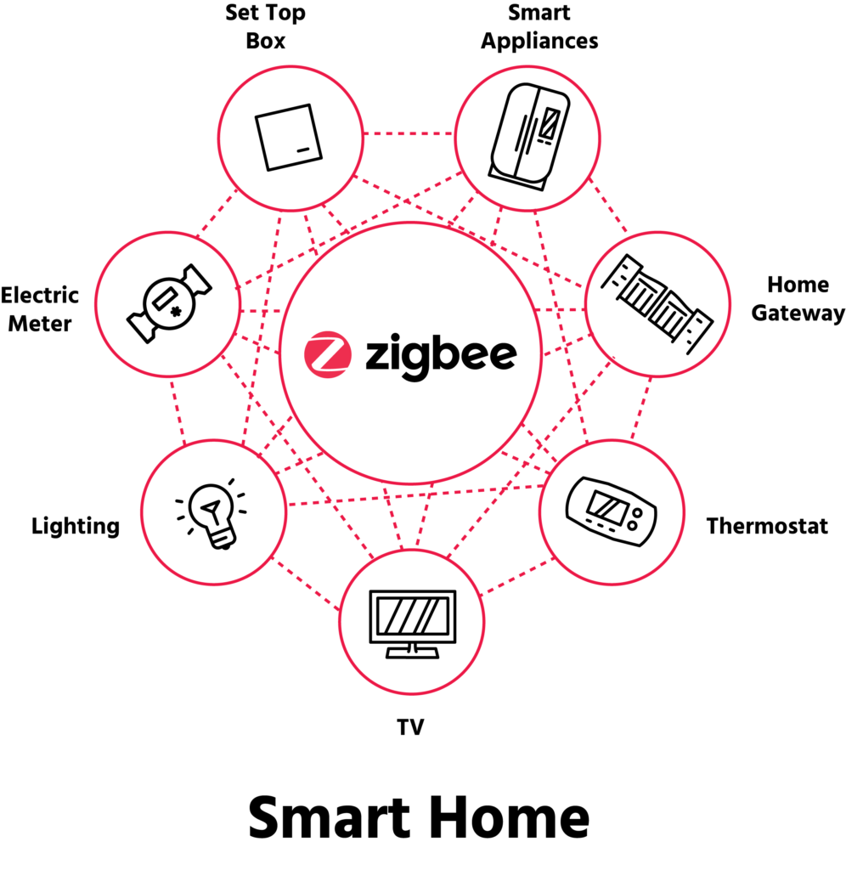
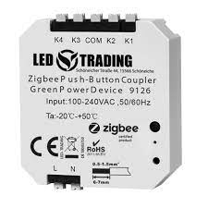
Internet of Thing
What is the status of the technologies and which data-driven approaches enable a connection to the IoT?
Wireless connectivity
Wireless connectivity technologies such as Wi-Fi, Bluetooth, and Zigbee are commonly used to connect IoT devices to the internet.
Zigbee: Zigbee is a low-power wireless communication technology used in IoT applications, such as smart homes and industrial automation, to connect devices over short distances.
Source: https://www.led-trading.de/media/image/product/5083/lg/9126_zigbee-unterputz-modul-fuer-friends-of-hue.png
Source: https://csa-iot.org/wp-content/uploads/2021/12/Zigbee_SmartHome-996x1024.png

Slide 15
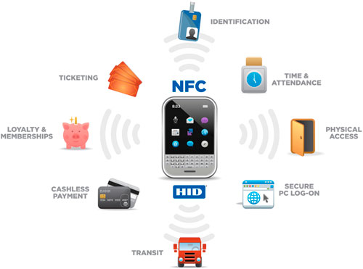

Internet of Thing
What is the status of the technologies and which data-driven approaches enable a connection to the IoT?
Wireless connectivity
Wireless connectivity technologies such as Wi-Fi, Bluetooth, and Zigbee are commonly used to connect IoT devices to the internet.
Zigbee: Zigbee is a low-power wireless communication technology used in IoT applications, such as smart homes and industrial automation, to connect devices over short distances.
NFC: Near Field Communication (NFC) is a wireless communication technology used for short-range communication between devices, such as smartphones and contactless payment systems.
https://www.datocms-assets.com/17144/1641212873-nfc-karte-terminal.png?auto=format
Source: https://www.libramation.com/Images/Products%20thumbs/Prod%20pics/nfc/nfcdiag.jpg

Slide 16
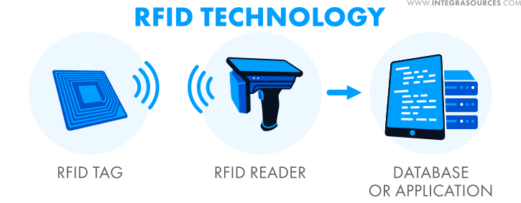
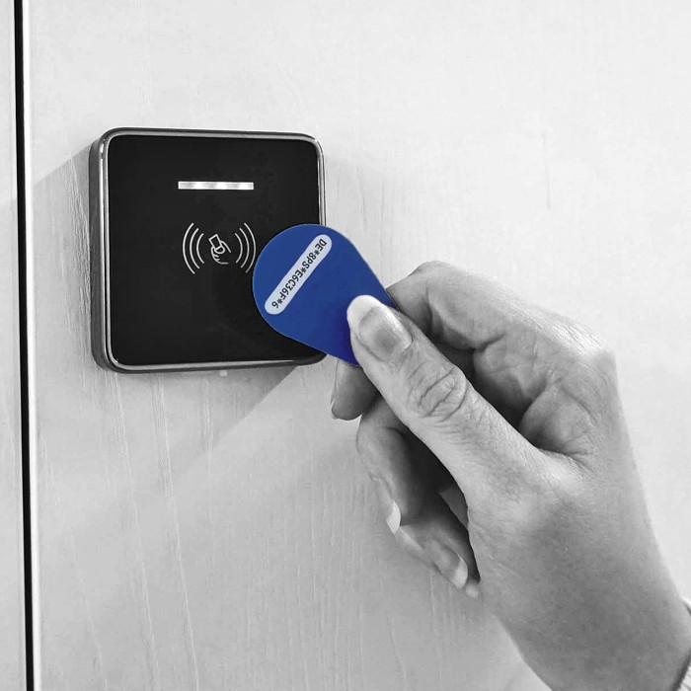
Internet of Thing
What is the status of the technologies and which data-driven approaches enable a connection to the IoT?
Wireless connectivity
Wireless connectivity technologies such as Wi-Fi, Bluetooth, and Zigbee are commonly used to connect IoT devices to the internet.
Zigbee: Zigbee is a low-power wireless communication technology used in IoT applications, such as smart homes and industrial automation, to connect devices over short distances.
NFC: Near Field Communication (NFC) is a wireless communication technology used for short-range communication between devices, such as smartphones and contactless payment systems.
RFID: Radio Frequency Identification (RFID) is a wireless communication technology used for tracking and identifying objects using radio waves.
Source: https://encrypted-tbn0.gstatic.com/images?q=tbn:ANd9GcQjx1XY2mFLLJ0EHCRFe35e627FvBmXEOn79w&usqp=CAU
Source: https://lh3.googleusercontent.com/WrVS_j0hVkDpffV_q3ZmdXvGrVrn4mEWePM-AMYRhAqN3w0LQ-Hm8dUZXPioF6Y7uoGGbKvP1VaMSTlKJVIM5XUYBjLuazVyUvJHOZrIA9OafWKIwWwkx7x9LDe046ow0FHn4TZEUh1z4hUbdyEsYu0

Slide 17
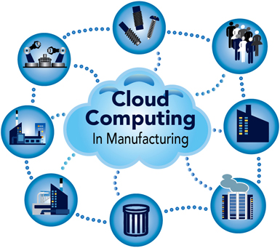
Internet of Thing
What is the status of the technologies and which data-driven approaches enable a connection to the IoT?
Wireless connectivity
Wireless connectivity technologies such as Wi-Fi, Bluetooth, and Zigbee are commonly used to connect IoT devices to the internet.
Cloud computing
Cloud computing platforms provide a scalable and cost-effective way to store and process large amounts of data generated by IoT devices.
Source: https://cdn9.areadevelopment.com/article_images/id32558_CloudComputingInfographic385.jpg

Slide 18
Internet of Thing
What is the status of the technologies and which data-driven approaches enable a connection to the IoT?
Wireless connectivity
Wireless connectivity technologies such as Wi-Fi, Bluetooth, and Zigbee are commonly used to connect IoT devices to the internet.
Cloud computing
Cloud computing platforms provide a scalable and cost-effective way to store and process large amounts of data generated by IoT devices.
Big Data Analytics
Big data analytics is a data-driven approach that involves analyzing large datasets to gain insights into patterns and trends. In the context of the IoT, big data analytics can be used to extract insights from the vast amounts of data generated by connected devices.
Machine Learning
Machine learning is a type of artificial intelligence (AI) that allows systems to automatically learn and improve from experience. In the context of the IoT, machine learning can be used to detect anomalies in data generated by connected devices and to optimize system performance.
Digital Twins
Digital twins are virtual replicas of physical objects or systems. In the context of the IoT, digital twins can be used to model and simulate connected devices and systems, allowing for improved optimization and predictive maintenance.

Slide 19
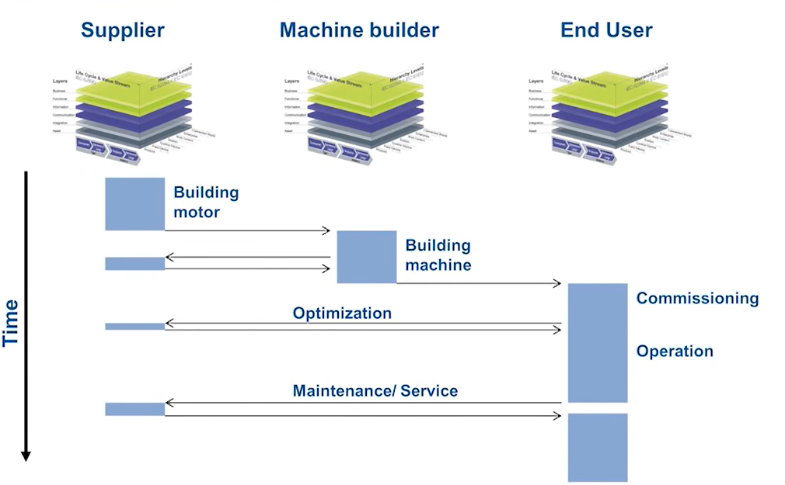

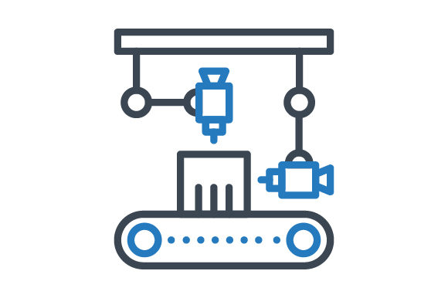
Digital Twin in the Motor Production
Where do we need Digital Represention?
Digital Factory Twin
Material Flow
Layout Plan
Documents
Digital Product Twin
Product Design
Simulation
Quality Control
Digital Machine Twin
MCAD/ECAD
Nameplate
Safety

Slide 20
Internet of Thing
What are those sectors that can benefit the most from IoT development?
The world of IoT:
According to a report by Statista, IoT technology holds significant potential across industries. The study predicts that there will be around 50 billion IoT devices connected by 2030.

Slide 21
Internet of Thing
What are those sectors that can benefit the most from IoT development?
The world of IoT:
According to a report by Statista, IoT technology holds significant potential across industries. The study predicts that there will be around 50 billion IoT devices connected by 2030.
Agriculture:
Agriculture industry has welcomed IoT innovations and has become more technology-driven by embracing IoT solutions.
Smart agriculture is the application of IoT in agriculture, where IoT sensors gather data to help farmers make informed decisions and improve their work.

Slide 22
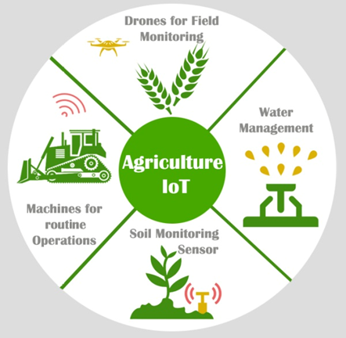
Internet of Thing
What are those sectors that can benefit the most from IoT development?
The world of IoT:
According to a report by Statista, IoT technology holds significant potential across industries. The study predicts that there will be around 50 billion IoT devices connected by 2030.
Agriculture:
Agriculture industry has welcomed IoT innovations and has become more technology-driven by embracing IoT solutions.
Smart agriculture is the application of IoT in agriculture, where IoT sensors gather data to help farmers make informed decisions and improve their work.
IoT in agriculture include agricultural drones for imaging and mapping farms, and greenhouse automation for optimizing plant growth. Soil and water management.
Source https://rb.gy/l8szbn

Slide 23
Internet of Thing
What are those sectors that can benefit the most from IoT development?
Energy :
IoT is transforming the energy sector across its entire value chain, from power generation to transmission and distribution, and changing the way energy companies and their customers interact with each other.

Slide 24
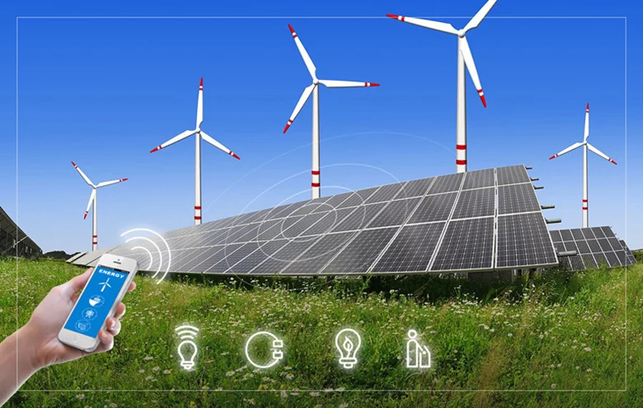
Internet of Thing
What are those sectors that can benefit the most from IoT development?
Energy :
IoT is transforming the energy sector across its entire value chain, from power generation to transmission and distribution, and changing the way energy companies and their customers interact with each other.
By implementing IoT technologies in these areas, the energy sector can achieve significant improvements in efficiency, cost-effectiveness, and sustainability.
Once you have installed sensors on devices creating
the Internet of Things, one of the primary uses is
in creating a smart lighting system for personal
usage at your home or a business purpose at
office premises.
Source https://rb.gy/24opbo

Slide 25
Internet of Thing
What are those sectors that can benefit the most from IoT development??
Finance:
With increasing security measures, financial transactions through IoT-connected devices are becoming commonplace for both banks and customers.
Connected devices can help user’s cultivate good financial habits and deal with any spending indulgent behavior.

Slide 26
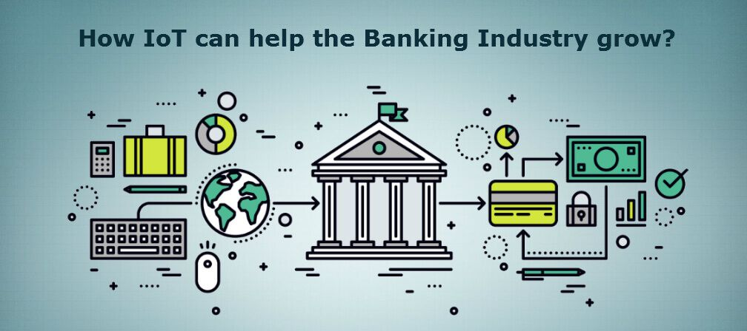
Internet of Thing
What are those sectors that can benefit the most from IoT development??
Finance:
With increasing security measures, financial transactions through IoT-connected devices are becoming commonplace for both banks and customers.
Connected devices can help user’s cultivate good financial habits and deal with any spending indulgent behavior.
It can improve the quality of the banking experience.
Interactive credit card for customers.
It has automated business processes for banks.
Source https://rb.gy/l8szbn

Slide 27
Internet of Thing
What are those sectors that can benefit the most from IoT development?
Health:
tracking systems and real-time health systems and is responsible for improving patient treatment, diagnosis, medical and diagnostic equipment maintenance, and remote surgeries.
Connected Healthcare is necessary for correct decisions, right actions, smart treatment, and thus patient satisfaction.

Slide 28

Internet of Thing
What are those sectors that can benefit the most from IoT development?
Health:
tracking systems and real-time health systems and is responsible for improving patient treatment, diagnosis, medical and diagnostic equipment maintenance, and remote surgeries.
Connected Healthcare is necessary for correct decisions, right actions, smart treatment, and thus patient satisfaction.
IoT devices offer healthcare organizations advantages such as cost reduction for patients, remote patient health monitoring, and shorter hospital stays.
IoT devices with sensors are used to track real-time
locations of medical equipment
Source https://rb.gy/l8szbn

Slide 29
Internet of Thing
What are those sectors catching up to do IoT development?
Construction :
One of the industries that lag behind in the use of new innovative technological tools is the construction industry.
Construction companies are facing a shortage of skilled staff due to the industry's growth and increasing labor needs.
manual operations are still a piler in constriction projects. it can be challenging to automate certain construction processes.

Slide 30
Internet of Thing
What are those sectors catching up to do IoT development?
Construction :
One of the industries that lag behind in the use of new innovative technological tools is the construction industry.
Construction companies are facing a shortage of skilled staff due to the industry's growth and increasing labor needs.
manual operations are still a piler in constriction projects. it can be challenging to automate certain construction processes.
A construction site is highly dynamic due to rapid changes and many moving parts
Common problems on-site are poor communication between project phases and actors, lack of information sharing, uncertainties, reliable deliveries and material flows

Slide 31
Internet of Thing
What are those sectors catching up to do IoT development?
Education :
The IoT is transforming the education sector and enabling educational institutions to become Wi-Fi-enabled smart learning environments.
Even though many colleges and universities are interested in using IoT to support student learning, some difficulties become a barrier to the widespread adoption of its tools.

Slide 32
Internet of Thing
What are those sectors catching up to do IoT development?
Education :
The IoT is transforming the education sector and enabling educational institutions to become Wi-Fi-enabled smart learning environments.
Even though many colleges and universities are interested in using IoT to support student learning, some difficulties become a barrier to the widespread adoption of its tools.
High implementation costs, privacy, security challenges.
inappropriate infrastructure for storing and processing data are among them.

Slide 33
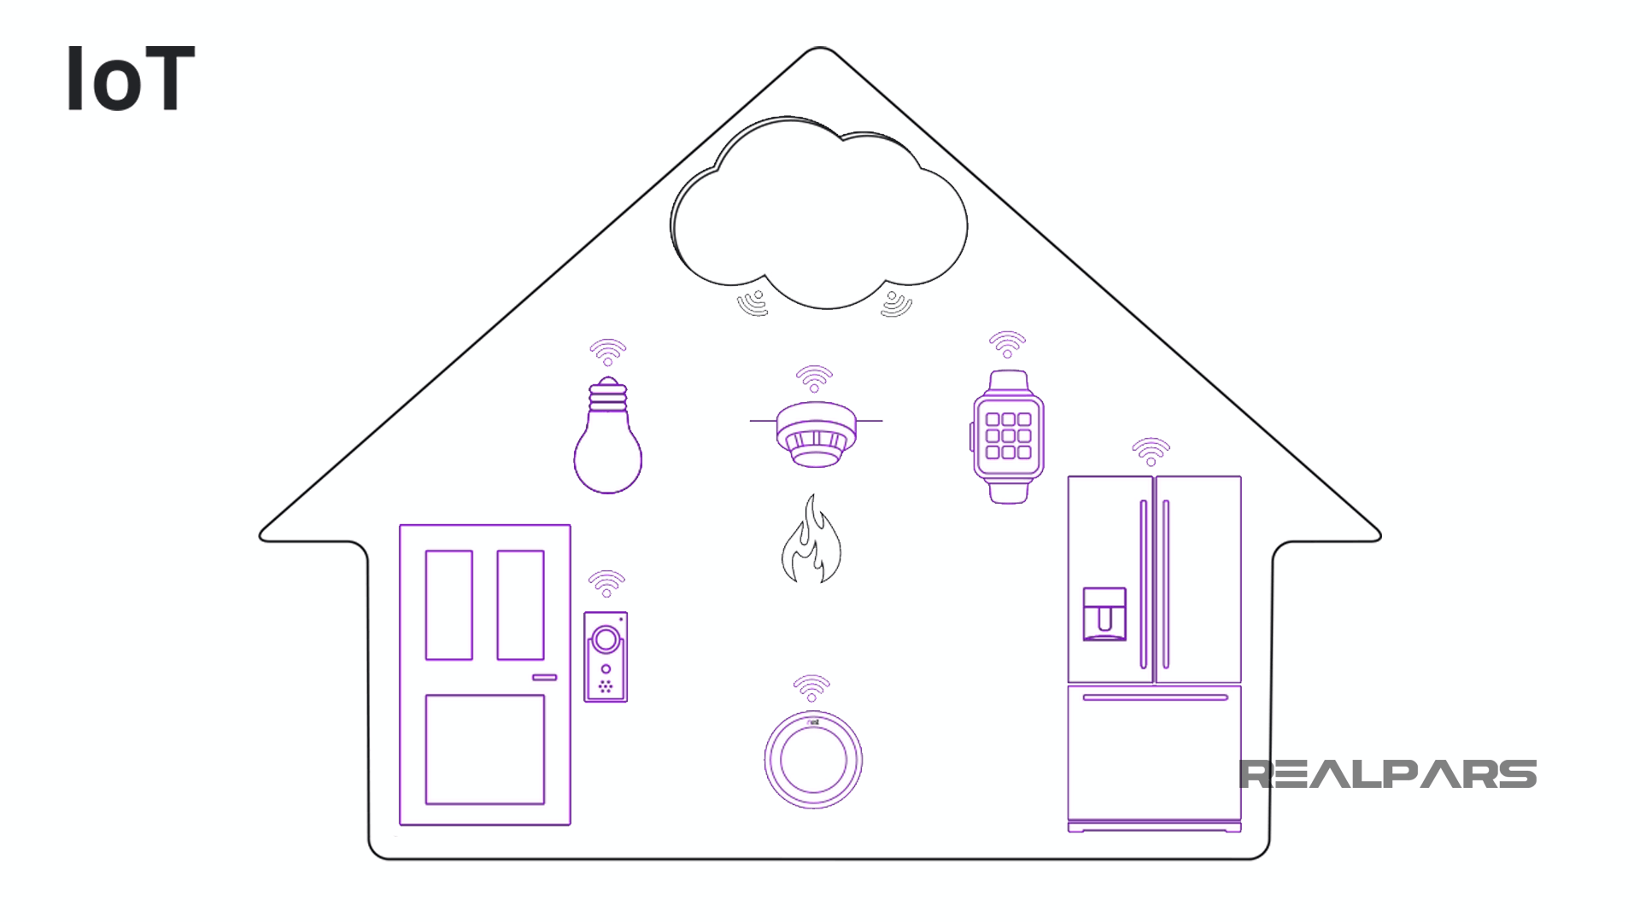
Internet of Thing
What is the IoT?
Internet of Things (IOT)
IoT is commonly used to define consumer-based devices.
like Fitbits, and a wide range of smart home devices, that are embedded with sensors and software's.
to transmit the data and to communicate among the devices through the Internet.
For example: air conditioners, sensors, smart watches, mobile phones etc.
https://realpars.com/iiot/

Slide 34
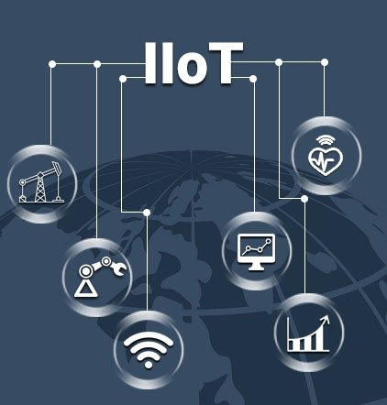
Internet of Thing
What is the Industrial Internet of Things (IIoT)?
Industrial Internet of Things (IIoT)
It is described as using the internet of things in industrial applications and sectors.
The IIOT refers to inter-connected sensors and other networked devices together with computer's industrial mainly used in manufacturing.
to transmit the data and to communicate among the devices through the Internet.
to enhance manufacturing and industrial processes.
For example: amazon warehouse, smart robotics etc.
https://www.biz4intellia.com/industrial-iot/

Slide 35
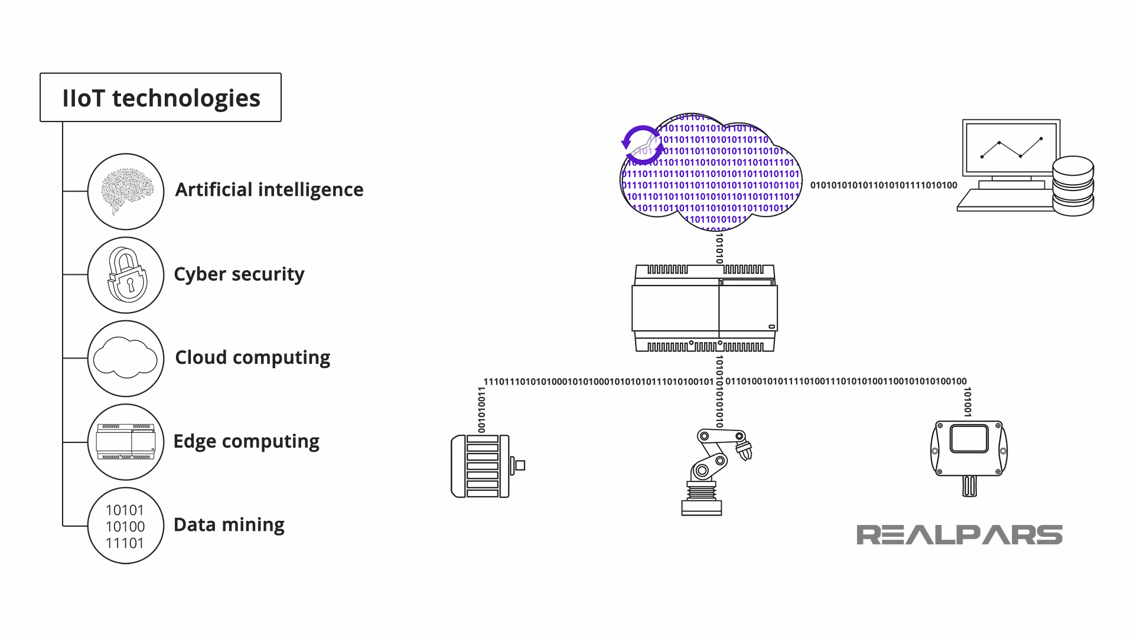
Internet of Thing
What are IIoT key technologies?
Industrial Internet of Things (IIoT)
the Industrial IoT depends on many technologies, the key technologies primarily consist of Artificial intelligence, Cyber security, Cloud computing, Edge computing, and Data mining..
https://realpars.com/iiot/

Slide 36
Internet of Thing
Benefits and Advancements of Industrial Internet of Things (IIoT)
Industrial Internet of Things (IIoT)
IIoT benefits to the integration of various devices such as sensors and instruments that are interconnected and communicate with computer-based industrial applications.
This technology is commonly used in manufacturing and energy management industries to enhance operational efficiency.
IIoT represents an advanced form of control system that enables significant automation improvements by utilizing cloud computing to optimize and enhance process controls.
connects the physical world to the internet, which allows us to use things remotely with ease of access.
The machines communicate with each other without human intervention, resulting in faster and more timely output.

Slide 37
Internet of Thing
What are IIoT applications and examples?
Industrial Internet of Things (IIoT)
It the benefits of IIoT in manufacturing, pharmaceuticals, agriculture, mining, Oil and Gas.
this new paradigm for solutions in optimizing operation of productivity.
smart utility aimed at cutting down on errors and enhancing industry components.

Slide 38
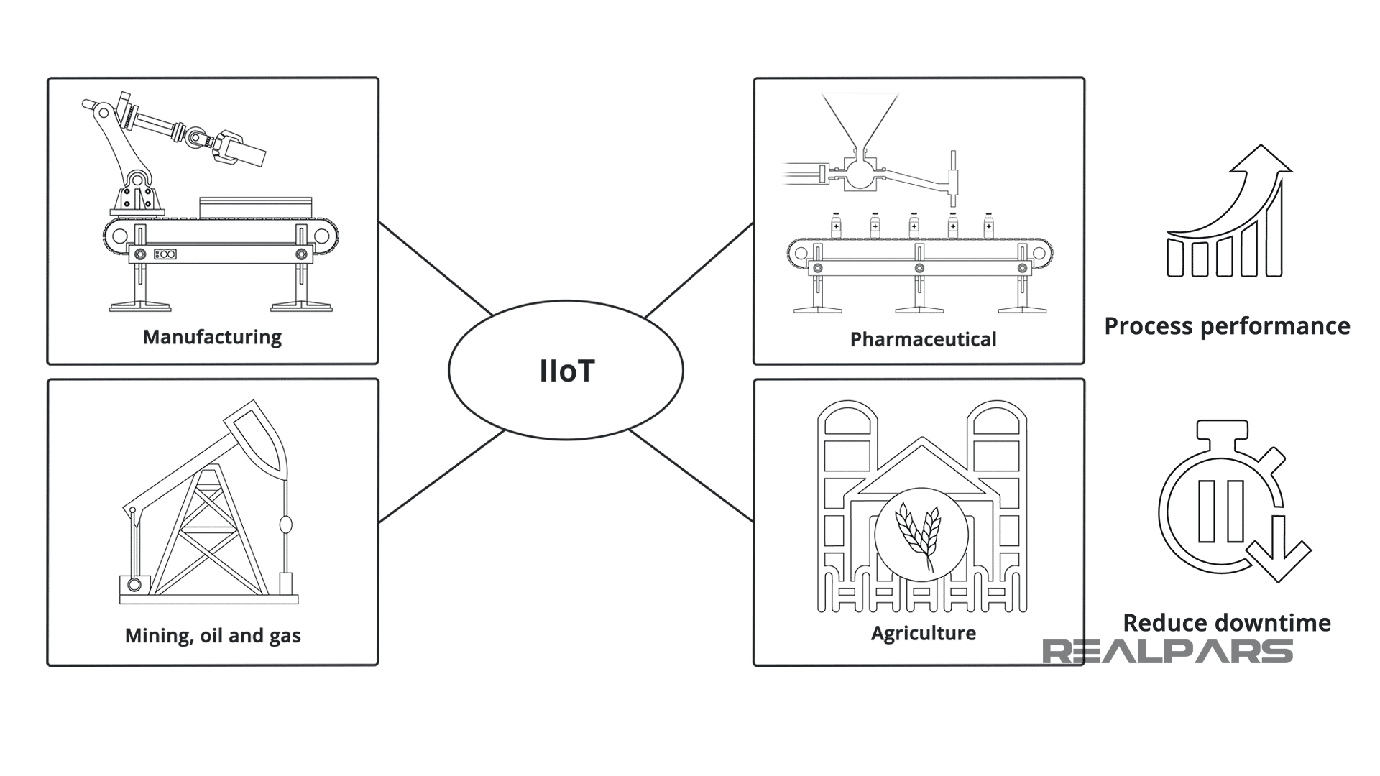
Internet of Thing
What are IIoT applications and examples?
Industrial Internet of Things (IIoT)
It the benefits of IIoT in manufacturing, pharmaceuticals, agriculture, mining, Oil and Gas.
this new paradigm for solutions in optimizing operation of productivity.
smart utility aimed at cutting down on errors and enhancing industry components.
https://realpars.com/iiot/

Slide 39
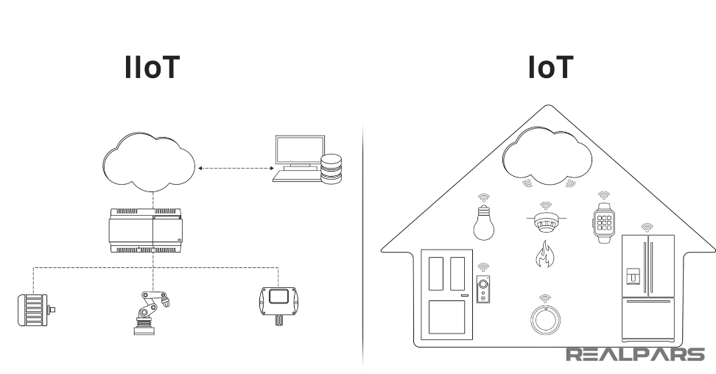
Internet of Thing
What is the difference between IoT and IIoT?
Difference?
https://realpars.com/iiot/

Slide 40
Internet of Thing
What is the difference between IoT and IIoT?
IOT and IIoT
Although IoT and IIoT have many technologies in common, including cloud platforms, sensors, connectivity, machine-to-machine communications and data analytic.

Slide 41
Internet of Thing
What is the difference between IoT and IIoT?
IOT and IIoT
Although IoT and IIoT have many technologies in common, including cloud platforms, sensors, connectivity, machine-to-machine communications and data analytic.
the key difference is IIoT concentrates on the connection of machines and devices in industries like manufacturing, healthcare, and logistics.
https://realpars.com/iiot/

Slide 42
Internet of Thing
What is the difference between IoT and IIoT?
IOT and IIoT
IIoT | IOT
Costly machines, sensors, systems, with heigh degree of difficulty Example: Robotics for Work Automation Remote access to robots prevents the robot’s unplanned downtime due to unexpected failure. It also gives notifications when you need to schedule your maintenance trip and be ahead of it. | User-level devices basically not much expensive Example: IoT device collecting location data with the help of GPS sensor. Asset Tracking and Supply Chain Tracking - Track asset as they move anywhere in the world.

Slide 43
Internet of Thing
What is the difference between IoT and IIoT?
IOT and IIoT
IIoT | IOT
Sensors are complicated Example: MEMS sensors to velocity and RFID to torque and pressure measuring devices. | Sensors are simpler Example: relies on relatively simple sensors to monitor temperature, motion, and water levels.

Slide 44
Internet of Thing
What is the difference between IoT and IIoT?
IOT and IIoT
IIoT | IOT
Deals with large scale networks Example: Smart grids, electrical grids that involve the same transmission lines, transformers, and substations as a traditional power grid. | Deals with small scale networks Example: The system could include sensors that measure temperature, humidity, pressure, and other variables of a work environment. send data to a central hub for analysis and processing.

Slide 45
Internet of Thing
What is the difference between IoT and IIoT?
IOT and IIoT
IIoT | IOT
Programming and Networking Example: The IIoT apps can be programmed remotely and in real-time. For maintenance purposes, businesses may need to have an IIoT programmer on staff. Robot situation monitoring | Programming and Networking Example: In contrast, most smart home devices can be easily programmed by downloading an app on your smartphone. Weather, location and smart TV programs.

Slide 46
Internet of Thing
What is the difference between IoT and IIoT?
IOT and IIoT
IIoT | IOT
More Secure Example: A secure IIoT architecture requires several critical components, including SSL encryption to secure communication, authentication of data in transit, encryption of data at rest, continuous monitoring of servers, closed-loop systems, and thumbprint login for added security. | Less Secure Example: less stringent network IoT security measures are needed to safeguard users’ private information. To now, data privacy has proven to be the most pressing concern regarding IoT security.

Slide 47
Internet of Thing
What is the difference between IoT and IIoT?
IOT and IIoT
IIoT | IOT
Usage Example: IIoT devices must withstand extreme conditions such as high velocity, temperature, and grease, and manufacturers must ensure their products can endure these conditions. Maintenance of both the cloud and networks is also crucial for IIoT. | Usage Example: smart home devices are not designed for heavy use and have a shorter lifespan than their industrial counterparts.

Slide 48
Internet of Thing
What is the difference between IoT and IIoT?
IOT and IIoT
IIoT | IOT
Huge Data processing Example: In principle, a significantly higher amount of data is required. Huge amounts of data have to be recorded and processed in production. | Less Data Example: In contrast, the private data volumes required for the Internet of Things are rather manageable and therefore significantly lower.

Slide 49
Internet of Thing
What is the difference between IoT and IIoT?
IOT and IIoT
IIoT | IOT
Fully automated Example: Fully automated processes up to the paperless smart factory | Partially automated Example: Partial automation of processes through digitization

Slide 50
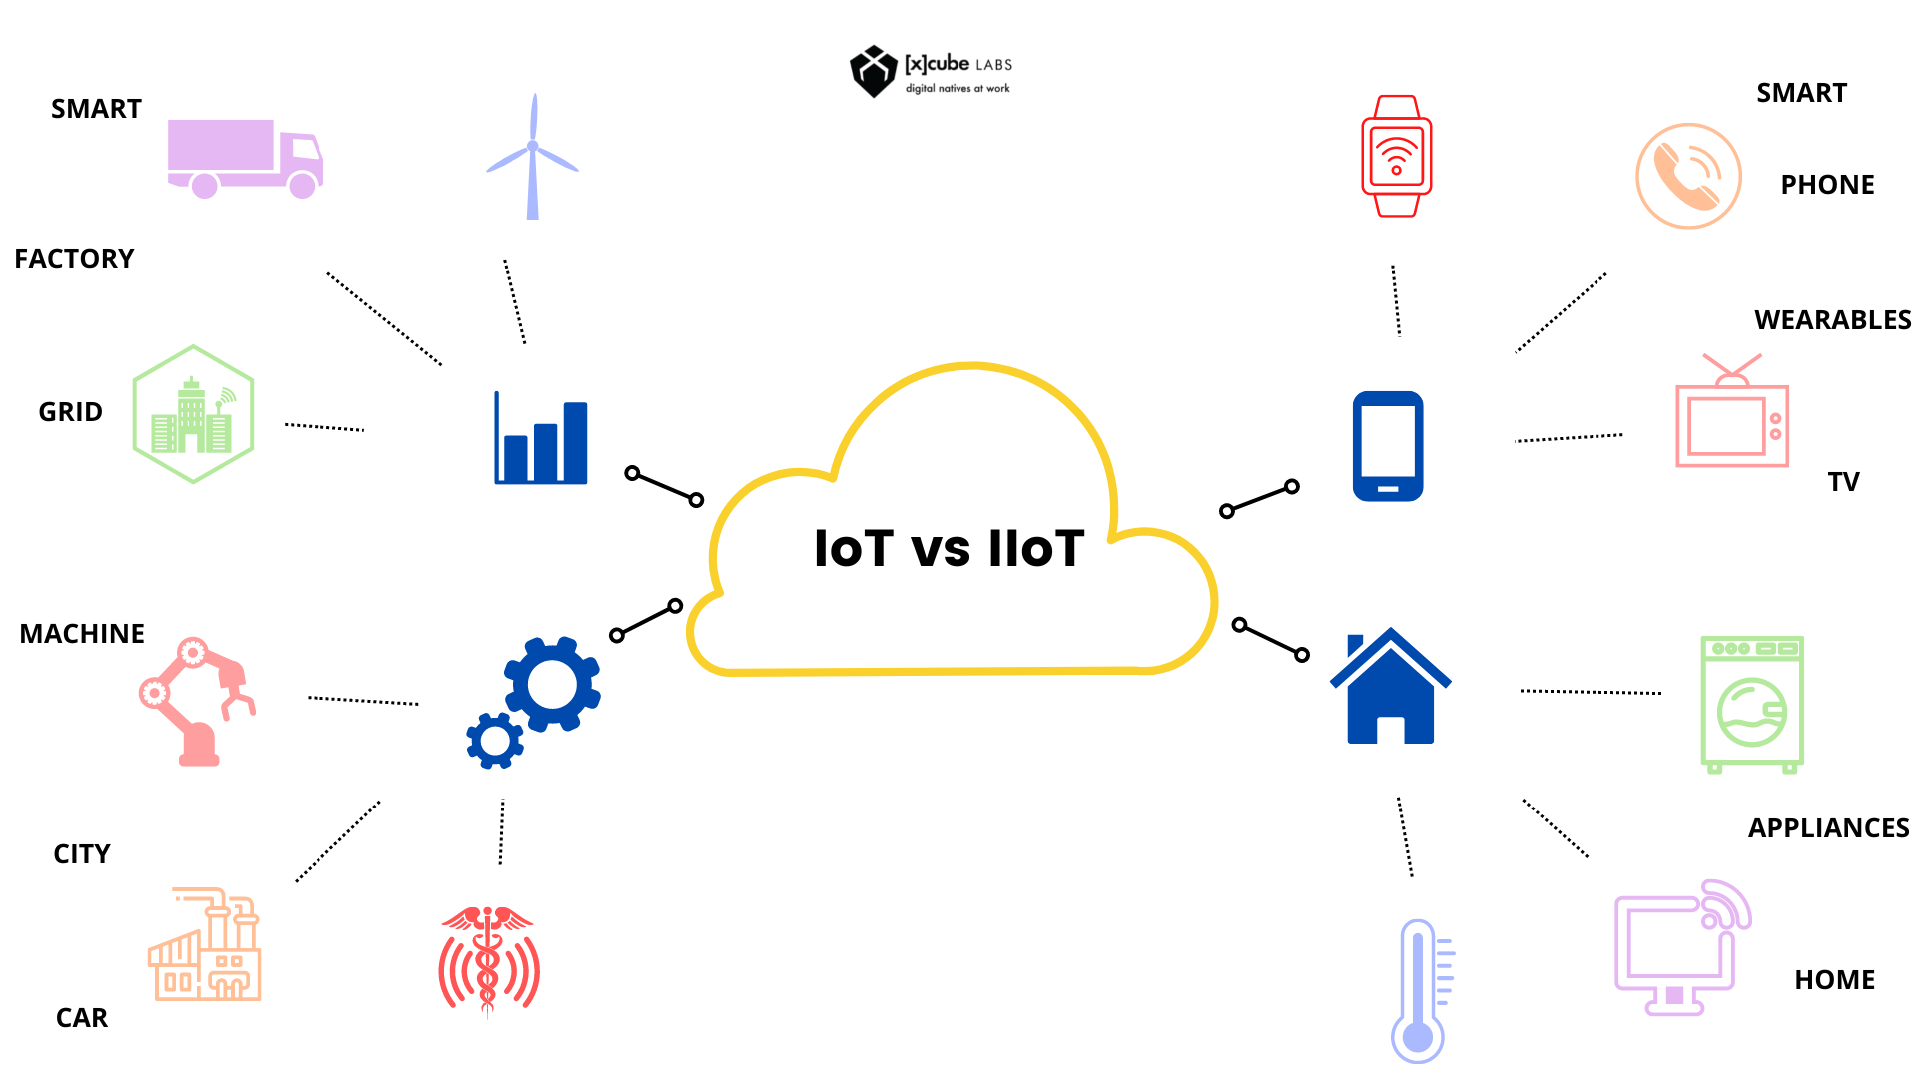
Internet of Thing
What is the difference between IoT and IIoT?
Summery
https://realpars.com/iiot/

Slide 51
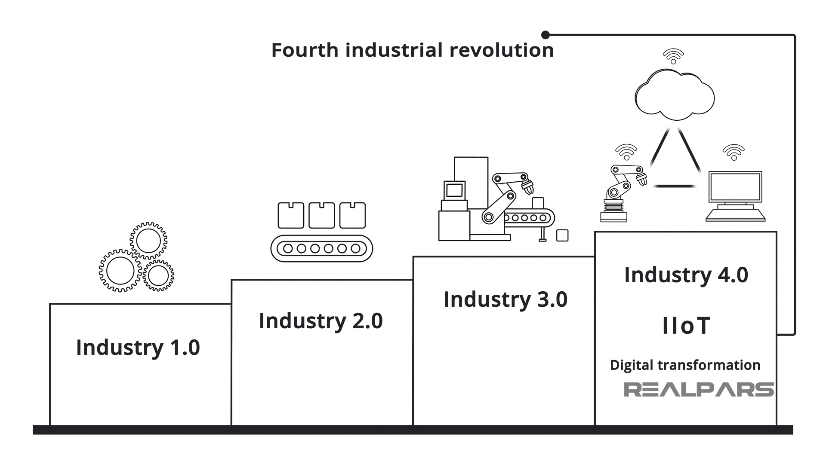
Internet of Thing
What is the future of IIoT?
future of IIoT
The future of IIoT is tightly coupled with Industry 4.0, which includes Industrial Internet of Things (IIoT) and Digital Transformation mechanisms that facilitate this evolved 4th generation period of Automation.
https://realpars.com/iiot/

Slide 52
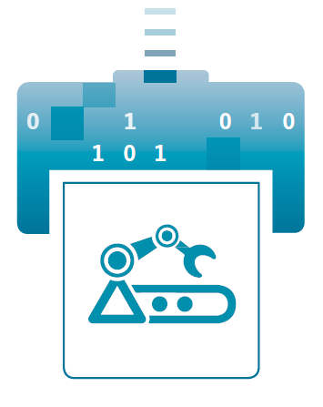
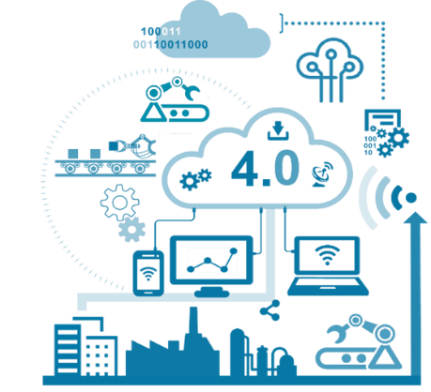


Asset Administration Shell(AAS)
Assets integrate into the IT world
What is Asset?:
Asset = everything that requires a "connection" for an Industry 4.0 solution.
Assets may be material or immaterial, and of various natures such as:
Machines and their components.
software (firmware, applications, engineering tools ...)
Supply materials, parts and products.
Exchanged documents (e.g., drawings, wiring diagrams).
Contracts.
Orders.
…
Asset Administration Sell
Asset
https://bit.ly/2H8c2Hn

Slide 53
Asset Administration Shell(AAS)
What is Administration Shell?
What is digital representation?:
Digital representation = information that represents characteristics and behaviors of an entity (asset).
the Asset Administration Shell is the implementation of the Digital Twin for Industrie 4.0.
The Administration Shell is the standardized digital representation of the asset.
Corner stone of the interoperability between the applications managing the manufacturing systems.
Administration Shell
Asset
https://bit.ly/3kZZSPl

Slide 54
Asset Administration Shell(AAS)
What is Administration Shell?
What is digital representation?:
Digital representation = information that represents characteristics and behaviors of an entity (asset).
the Asset Administration Shell is the implementation of the Digital Twin for Industrie 4.0.
The Administration Shell is the standardized digital representation of the asset.
Corner stone of the interoperability between the applications managing the manufacturing systems.
Why AAS?:
The Asset Administration Shell covers the complete life cycle of products, devices, machines and facilities.
The Asset Administration Shell is the digital basis for autonomous systems and AI.
Administration Shell
Asset
https://bit.ly/3kZZSPl

Slide 55
Asset Administration Shell(AAS)
Interoperability
Interoperability is the key enabler of Smart Manufacturing:
Interoperability is commonly defined as the capability of two or more objects or systems, regardless of whether they are made by the same or different vendors, to share information and use that information to work together correctly.
Components or systems are considered interoperable if they can function cooperatively to accomplish a specific task by exchanging information.
Asset Administration Shell (AAS) is used as a means of achieving interoperability between different companies.
To achieve smooth interoperability between different systems, it is important to have a common understanding and interpretation of the data being exchanged.
Object A
Object B
Information exchange
Function
https://bit.ly/3kZZSPl

Slide 56
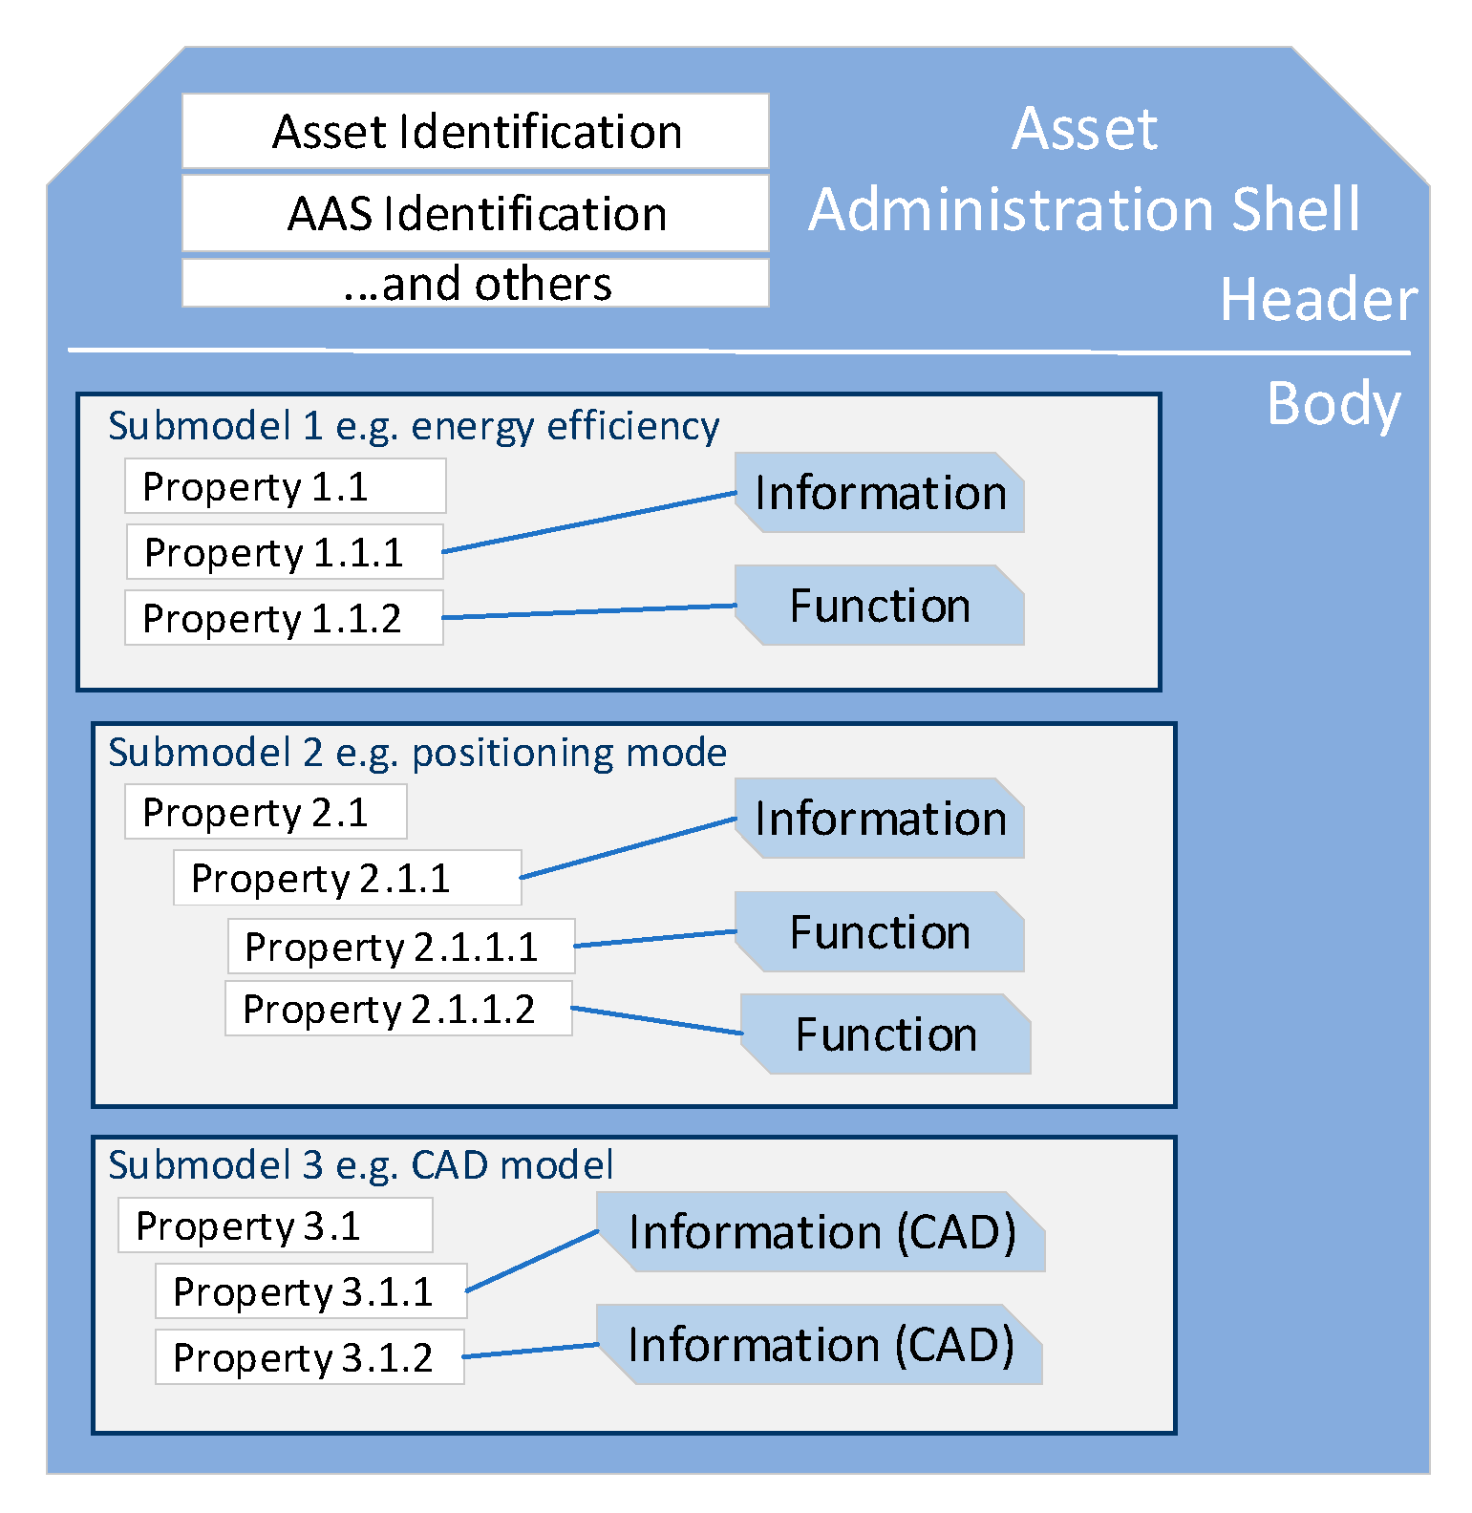


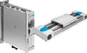
Asset Administration Shell(AAS)
Structure of the Administration Shell
AAS Structure :
AAS is structured in header and body.
Admiration Shell Header:
Provides identification and designation of the asset(s) and of the Administration Shell.
Admiration Shell body :
administers individual submodels within the Administration Shell.
Each submodel has hierarchically organized properties, which refer to individual information and functions .
Administration Shell
Administration Shell
=
Asset, e.g. Electrical axis
https://bit.ly/3kZZSPl

Slide 57
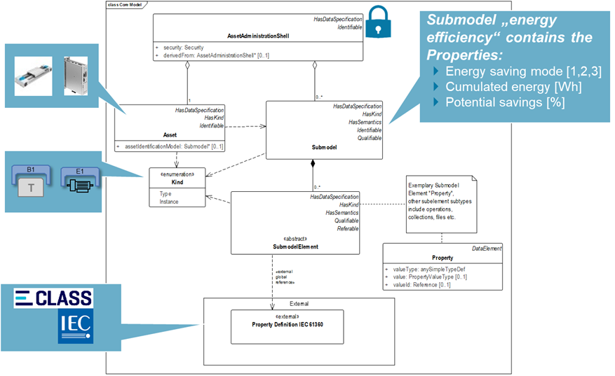
Asset Administration Shell(AAS)
Meta Model of the Asset Administration Shell
Meta Model:
Represented in the form of a UML class diagram.
The boxes are the Classes.
The relationships between the Classes are shown as lines with different end symbols.
Inherited Classes not contained in the diagram are listed in the top right corner.
https://bit.ly/3kZZSPl

Slide 58
Asset Administration Shell(AAS)
Structure of the Administration Shell
The concept of submodel:
Each submodel can characterize the asset by describing its aspects in different domains.
Domain examples include identification, communication, engineering, safety, security, lifecycle status, energy efficiency, health status, process control.
Submodels also describe the asset’s functions: drilling, milling, welding, assembling, mixing, heating, reacting, etc.
Each submodel is described by several properties defined by a unique global identifier and a set of well-defined attributes.
AAS attributes are preferred name, symbol, unit of measure, definition.
https://bit.ly/3kZZSPl

Slide 59
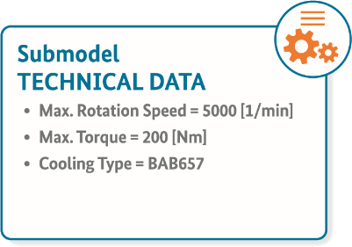
Asset Administration Shell(AAS)
Structure of the Administration Shell
Submodels contain submodel elements:
Each submodel can characterize the asset by describing its aspects in different domains.
Product properties in terms of IEC61360-1 or ecl@ss
Process variables and parameters, telemetry data
Operations that do actions.
Events to observe properties etc.
References to external data sources or files.
Capabilities of the asset, description of method calls.
Sets of properties, e.g., lists or arrays
https://bit.ly/3kZZSPl

Slide 60
Asset Administration Shell(AAS)
Standardization of Asset Administration Shell
Standardization:
AAS must be standardized to enable exchanges.
a unique and consistent identifier for the classification of equipment, properties, and units that are generally used in application systems.
Well-known reference data include ISO 15926 RDL, IEC 61360 CDD, and eClass.
ISO 15926 provides information resources and implementation methods for exchanging, sharing, and integrating life cycle data of a process plant.
The manufacturer provides the standardized digital representation to his customers, creating both an Asset Administration Shell for the asset type and for asset instance.

Slide 61
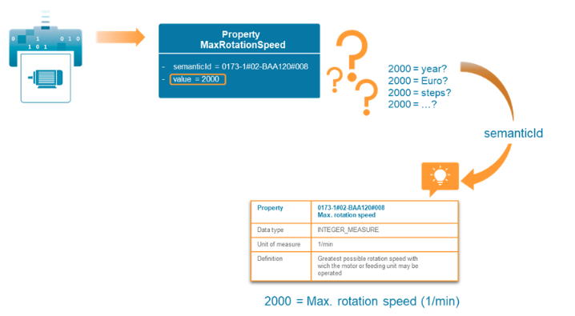
Asset Administration Shell(AAS)
AAS referencing Concept Descriptions
Semantic ID:
the most important attribute of elements within the meta model of the AAS is the one inherited by the Class “HasSemantics”, the “semanticId”.
An example An AAS Property “MaxRotationSpeed” consists of a pair “Value” being “2000” and a semanticId.
The value of the semanticId attribute should be the IRDI of a Concept Description in ECLASS. The AAS Property without this information of the ECLASS Concept Description does not reveal anything about the meaning or the physical Unit of the value “2000”.
https://bit.ly/3kZZSPl

Slide 62
Asset Administration Shell(AAS)
AAS Property Mapping
Mapping asset and corresponding properties:
The IoT data is often exchanged in JSON or XML formats, which include specifications for syntactic structures of data objects, while customized data models and schemata provide additional information on the meaning of keys/values, and the Platform Industrie 4.0 Asset Administration Shell (AAS) also follows this convention.
Information and data can be exchanged in a package (file group) from one partner to the next in a standardized way (XML, JSON, .aasx).
The Administration Shell object (AAS) is the root of every Asset Administration Shell. As the root entity, it is also the entry point for traversing the AAS graph.

Slide 63
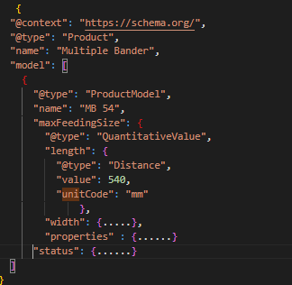


Asset Administration Shell(AAS)
AAS Property Mapping
Mapping asset and corresponding properties:

